Slide 1
Digital Portfolio
STUDENT NAME:Santhosh.k
REGISTER NO AND NMID: 222410978
DEPARTMENT: B.sc (COMPUTER SCIENCE)
COLLEGE: SRI BALAJI ARTS & SCIENCE COLLEGE/MADRAS UNIVERSITY

Slide 3


AGENDA
Problem Statement
Project Overview
End Users
Tools and Technologies
Portfolio design and Layout
Features and Functionality
Results and Screenshots
Conclusion
Github Link
3/21/2024 Annual Review

Slide 4

PROBLEM STATEMENT
In today’s competitive environment, individuals struggle to effectively showcase their skills, projects, and achievements in a professional way. Traditional resumes and static profiles fail to capture creativity, personality, and technical ability. Lack of an online presence reduces opportunities for networking, internships, and career growth. There is a need for a responsive, visually appealing, and accessible personal portfolio website that highlights one’s skills, projects, and achievements across all devices.

Slide 5

Project Overview
The project focuses on developing a responsive personal portfolio website to showcase an individual’s skills, projects, and achievements in a professional and creative way. The website will serve as a digital resume and portfolio, highlighting technical expertise, creativity, and personal branding. It will be designed with a user-friendly interface and responsive layout to ensure compatibility across devices (desktop, tablet, and mobile). The portfolio will include key sections such as About Me, Skills, Projects, Resume, and Contact Information.

Slide 6

WHO ARE THE END USERS?
Definition: End users are the final audience or customers who interact directly with the outcome of your project. Role: They are not necessarily the buyers or decision-makers, but the people who actually operate, experience, or benefit from what’s delivered. Importance: Understanding end users ensures the project meets real needs, is user-friendly, and provides value.

Slide 7

TOOLS AND TECHNIQUES
Research tools and techniques (e.g., surveys, interviews, data analysis methods) Project management tools and techniques (e.g., Agile, Gantt charts, Jira, Trello) Teaching/learning tools and techniques (e.g., digital tools, active learning methods) Problem-solving tools and techniques (e.g., brainstorming, root cause analysis, mind mapping) Technical tools and techniques in a specific field (like software development, engineering, art, etc.)

Slide 8
POTFOLIO DESIGN AND LAYOUT
Clean Title Slide – Include your name, role, and a simple background for a professional look. About Me Section – Short intro with photo, education, and skills using icons or infographics. Skills Showcase – Display technical and soft skills with progress bars, charts, or visuals. Projects/Portfolio Grid – Highlight your best works with screenshots, tools used, and short descriptions. Contact / Thank You Slide – Provide your email, LinkedIn, GitHub, and a QR code for easy access.
8
ChatGPT You said: Projectptt portfolio design and layout ChatGPT said: Got it 👍 You want ideas for design and layout for your Portfolio Project PPT. Here’s a structured breakdown you can use for your slides: 📑 Portfolio PPT – Design & Layout Guide 1. Title Slide Clean minimal background (solid color / gradient / abstract). Your Name, Title (e.g., Web Developer, Designer, Student). Add a logo or personal icon. Optional: a tagline (e.g., "Showcasing Creativity through Code & Design"). 2. About Me Profile photo (professional / creative). Short intro (education, skills, passion). Icons instead of long text (e.g., 🎓 Education, 💻 Skills, ✨ Interests). 3. Skills Use infographics, progress bars, or icons. Split into categories: Technical Skills (HTML, CSS, JS, Python, etc.) Soft Skills (Communication, Problem-solving, Teamwork). 4. Portfolio / Projects Grid layout (images/screenshots + project titles). Each slide → 1 project highlight: Screenshot / Demo image Tools used Short description Link (if live/hosted) 5. Design Approach / Process Flowchart or step-by-step timeline: Research → 2. Design → 3. Development → 4. Testing → 5. Deployment Use icons for clarity. 6. Experience (If any) Timeline or cards with company logos. Key contributions in bullet points. 7. Achievements / Certifications Certificates, awards, or recognitions. Minimal, clean showcase with icons. 8. Contact / Thank You Professional contact info (Email, LinkedIn, GitHub, Portfolio site). QR code (links directly to portfolio site / LinkedIn). “Thank You” note with a subtle animation or image. 🎨 Design Tips Stick to 2–3 colors (personal branding). Use consistent fonts (1 for headings, 1 for text). Add white space → makes slides breathable. Icons > Long text (visual storytelling). Keep it responsive theme (show screenshots of mobile + desktop views). 👉 Do you want me to create a sample PPT layout (with ready-to-edit slides) for your portfolio project? No file chosenNo file chosen ChatGPT can make mistakes. Check important info. See Cookie

Slide 9
FEATURES AND FUNCTIONALITY
Responsive Design – Works smoothly on desktop, tablet, and mobile devices. Interactive UI – Clean navigation with animations and hover effects. Project Showcase – Dedicated sections with images, descriptions, and live/demo links. About Me Section – Profile, skills, and background details. Contact Form – Easy way for users to reach out via email/message.

Slide 10
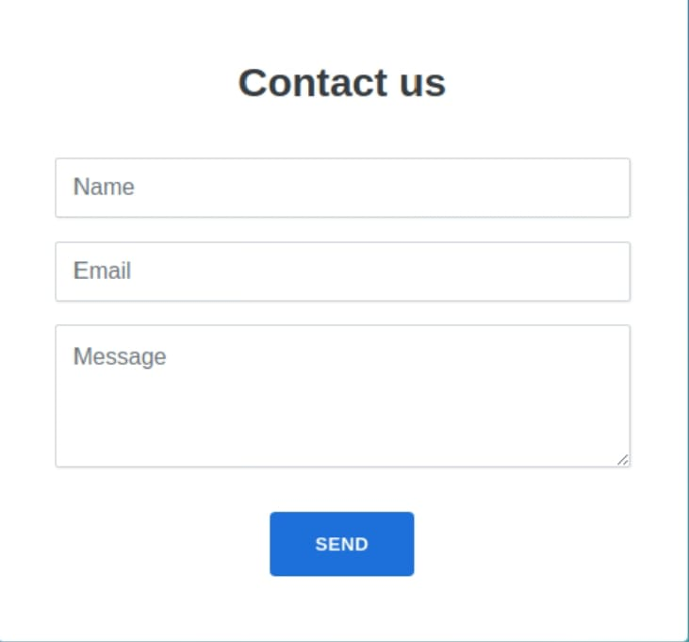

RESULTS AND SCREENSHOTS
The portfolio website is fully responsive (works on desktop, tablet, and mobile). Clean UI showcasing personal details, skills, projects, and contact form. Integrated smooth navigation and interactive design. Portfolio helps in highlighting achievements and can be shared as a professional profile. Improved accessibility and visibility compared to a static resume.
3/21/2024 Annual Review
10

Slide 11
CONCLUSION
A responsive personal portfolio website was successfully developed. It provides a professional platform to showcase skills, projects, and achievements. The design ensures user-friendly navigation and works seamlessly across devices. This project enhances personal branding and can be used for career opportunities. Future improvements can include adding a blog section, dark mode, and animations.
11

